Slide 1
Introduction + overview of emerging approaches to measuring impact
Adrian Barnett, QUT
@aidybarnett
Thursday, October 4th, 2018

Slide 2
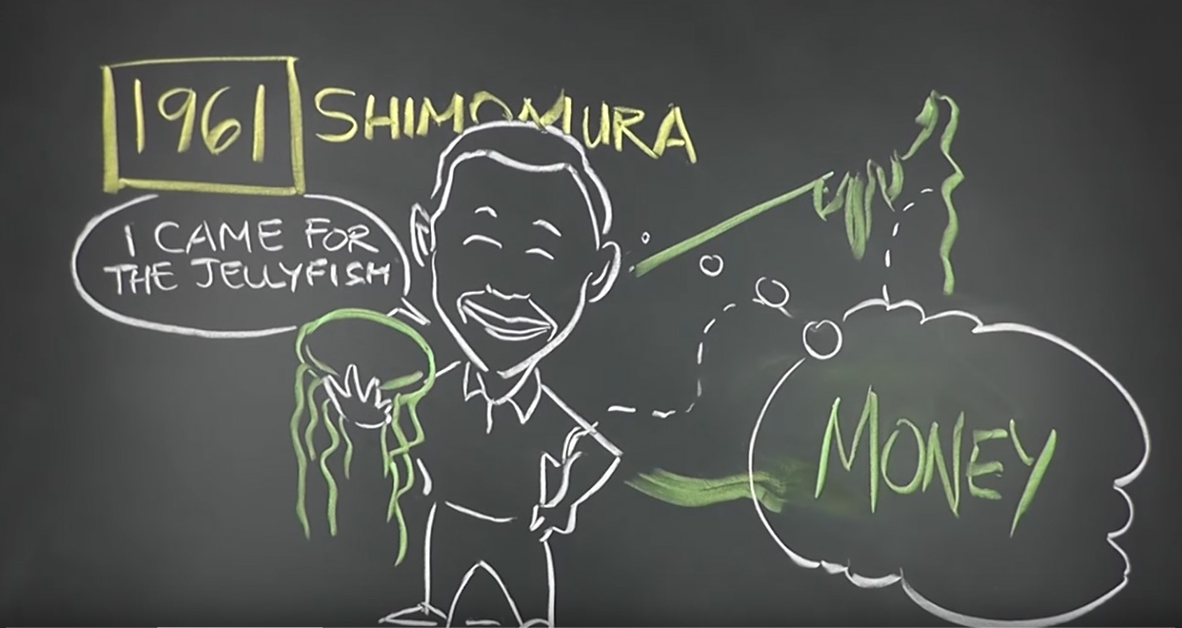
Jellyfish!
https://youtu.be/8vu68c4Rf6A

Slide 3
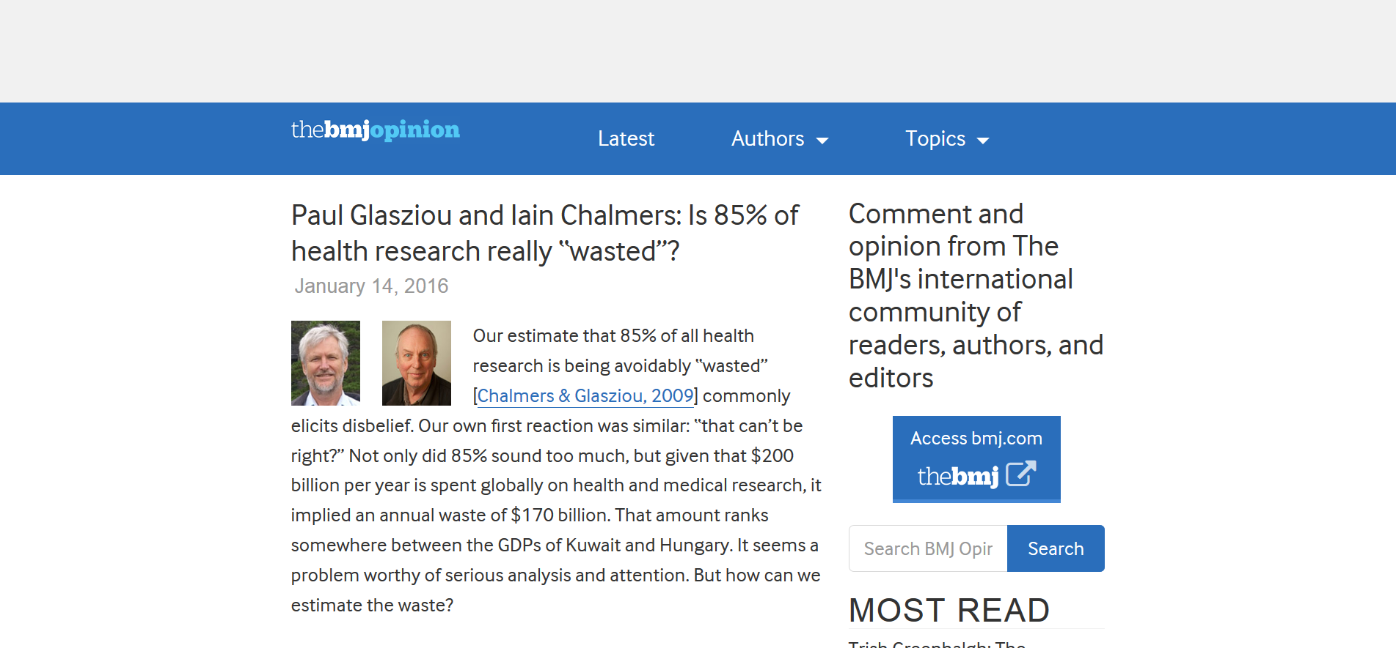
Research waste

Slide 4
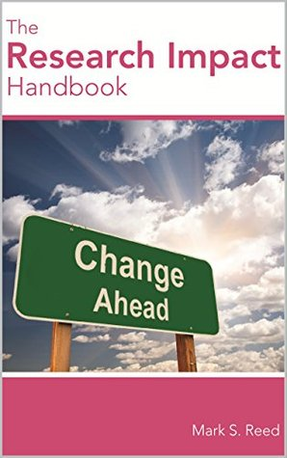
What is research impact?
Prof Mark Reed: “Benefits”
https://www.fasttrackimpact.com/podcast

Slide 5
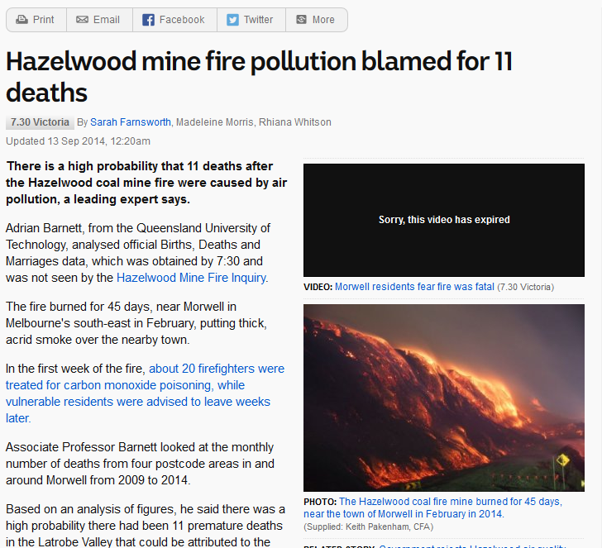

Slide 6
My part in coal’s downfall
My analysis of deaths during the extreme air pollution caused by the Hazelwood Mine Fire in Victoria was requested by both Victorian Labor and the Greens.
My report was used to direct questions in the Victorian parliament to the Health Minister and Premier with several mentions in Hansard.
I discussed my report in an interview with the ABC 7:30 Report Victoria, and the report was used by the local community group Voices of the Valley.
My analysis was a key reason for the re-opening of the inquiry into deaths during the fire by the Labor government.
I participated in an expert conclave and gave evidence for three days during the health public hearing in Victoria.
Counsel assisting the inquiry stated in their closing submission that I should be commended for my assistance to a community organisation.
The Hazelwood coal mine closed in March 2017. In June 2017 the owners of the mine were committed to stand trial including charges for failing to ensure the public was not exposed to risks.

Slide 7
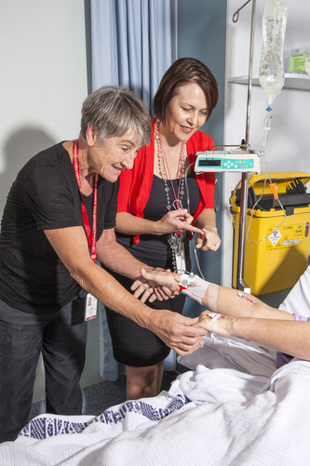
Lost in translation
Claire Rickard and Joan Webster
Routine replacement of lines

Slide 8
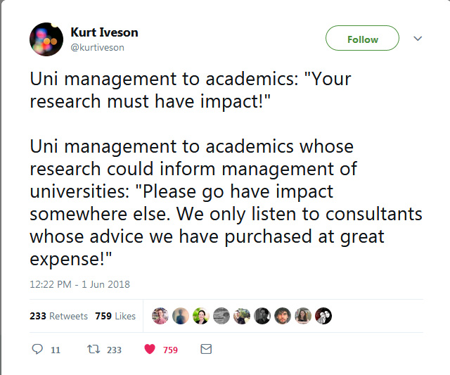

Slide 9
Some ways of measuring impact

Slide 10
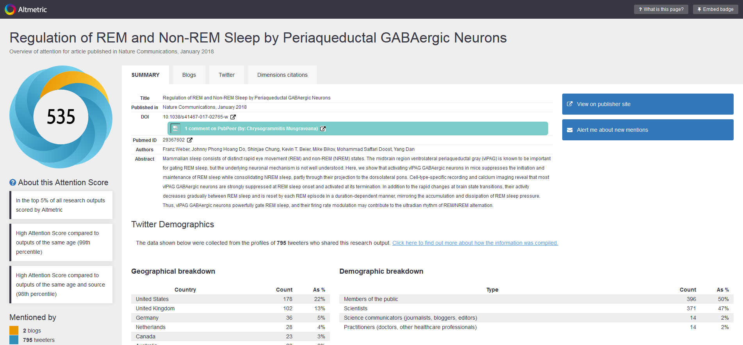
Altmetrics
"we continuously increased the number of animals until statistical significance was reached to support our conclusions."

Slide 11
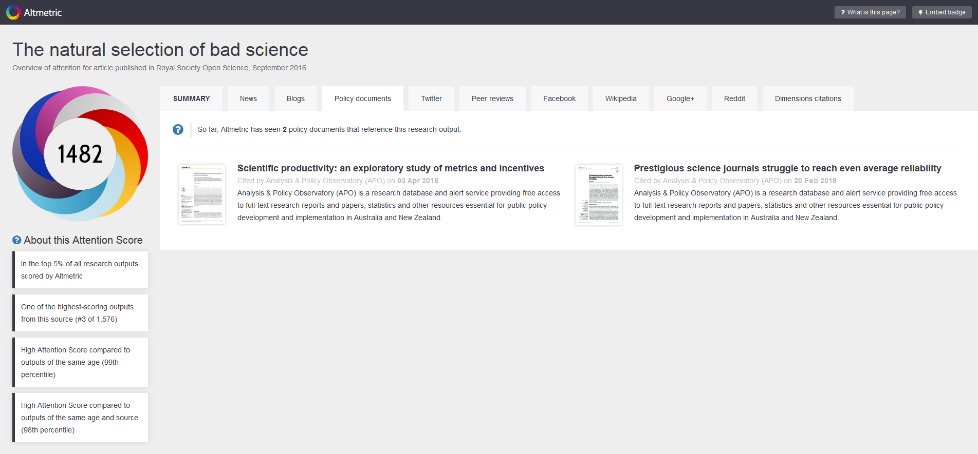

Slide 12
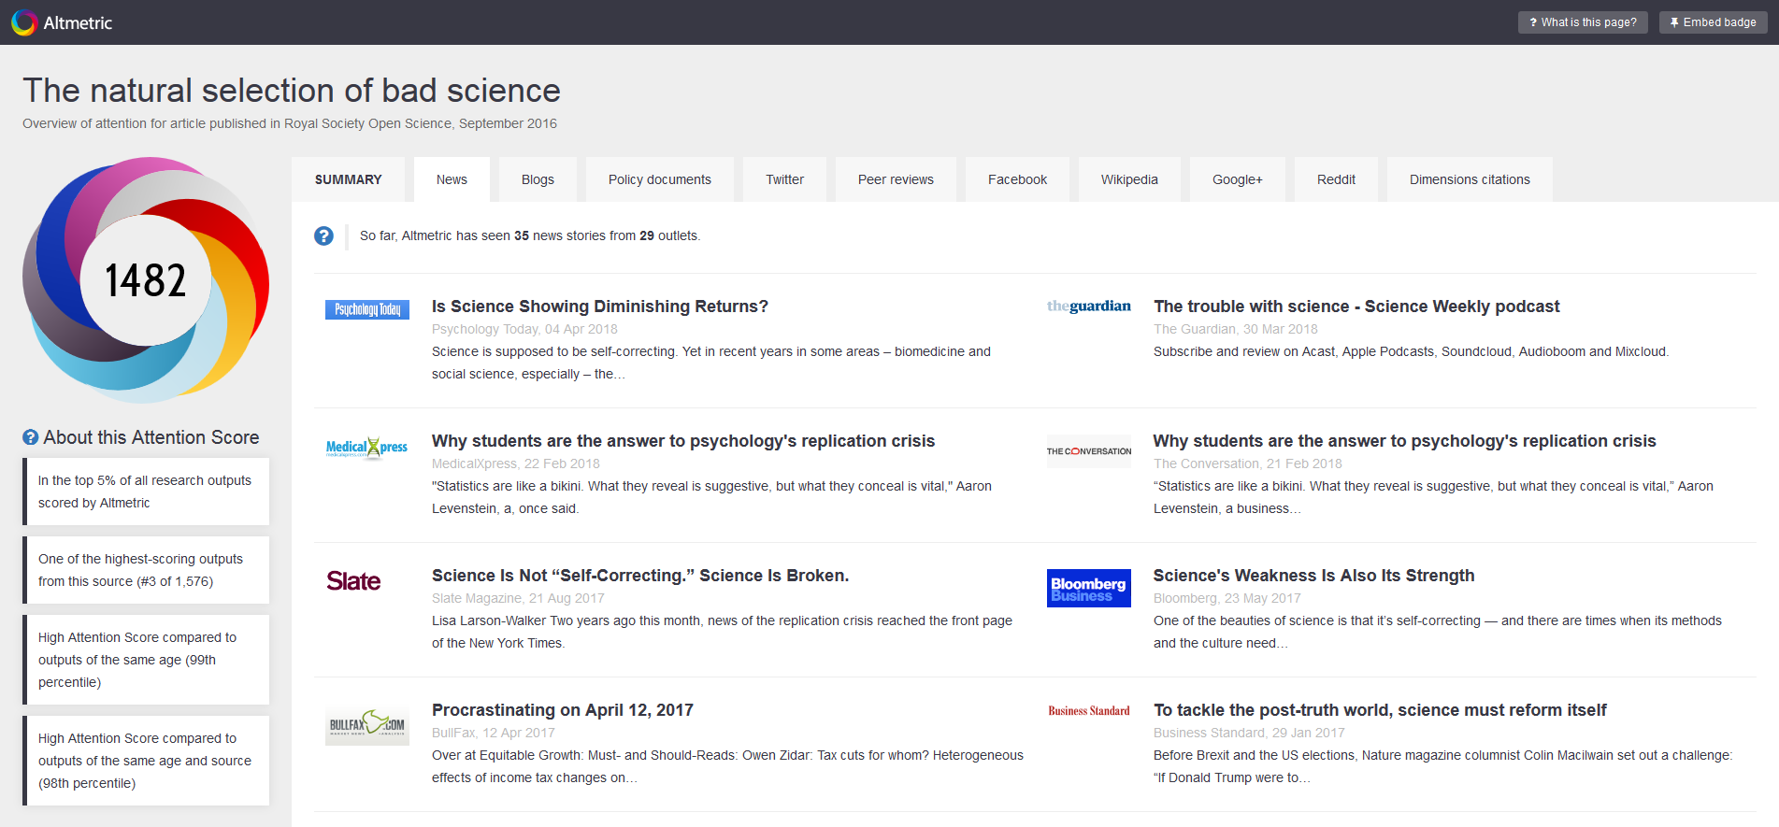

Slide 13
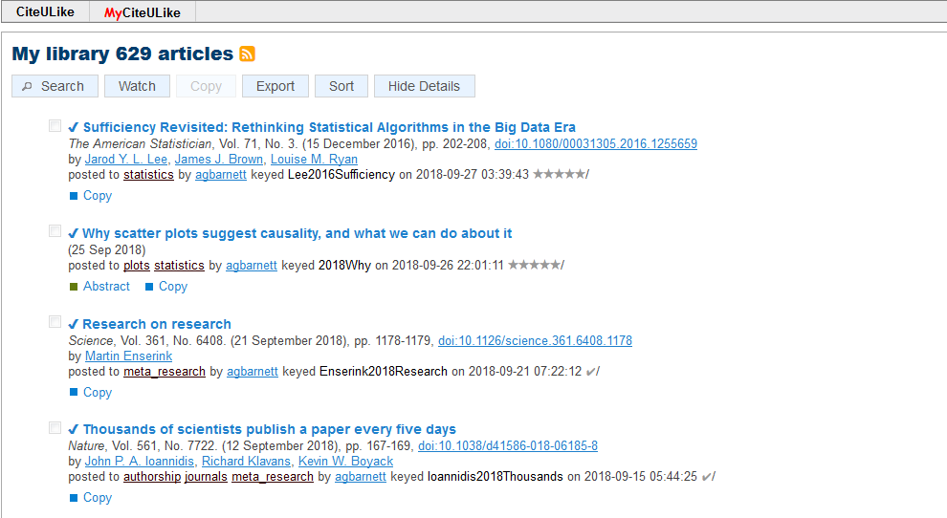
citeulike – who is reading your work?

Slide 14
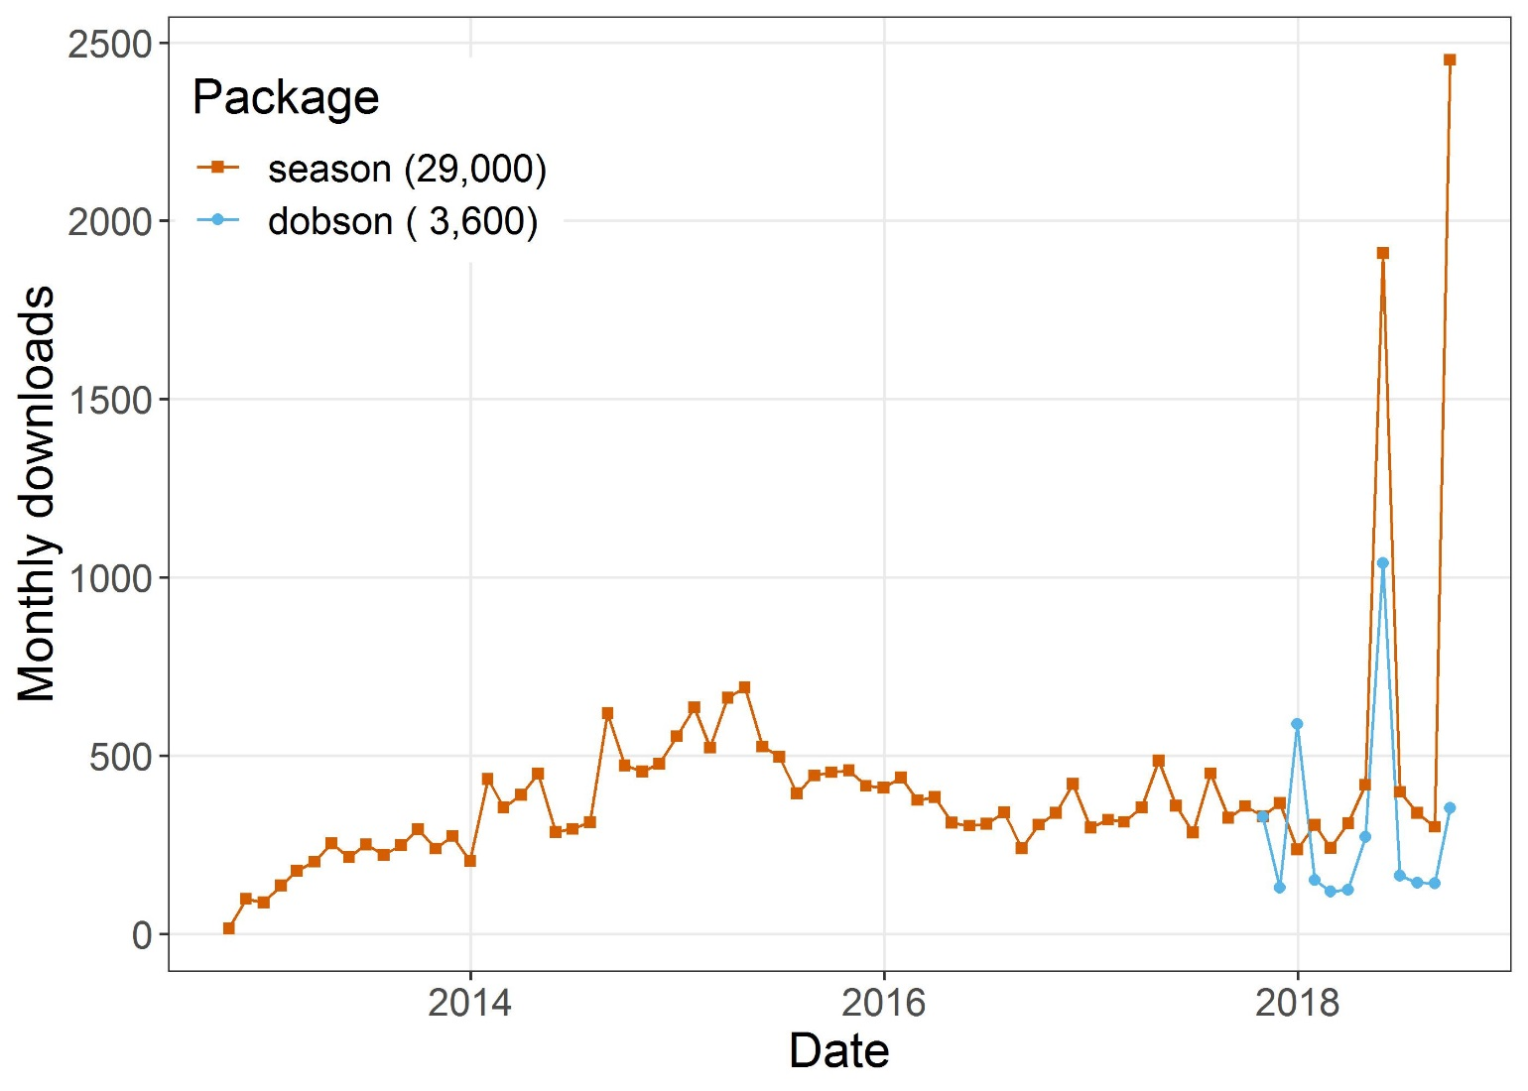
Software

Slide 15
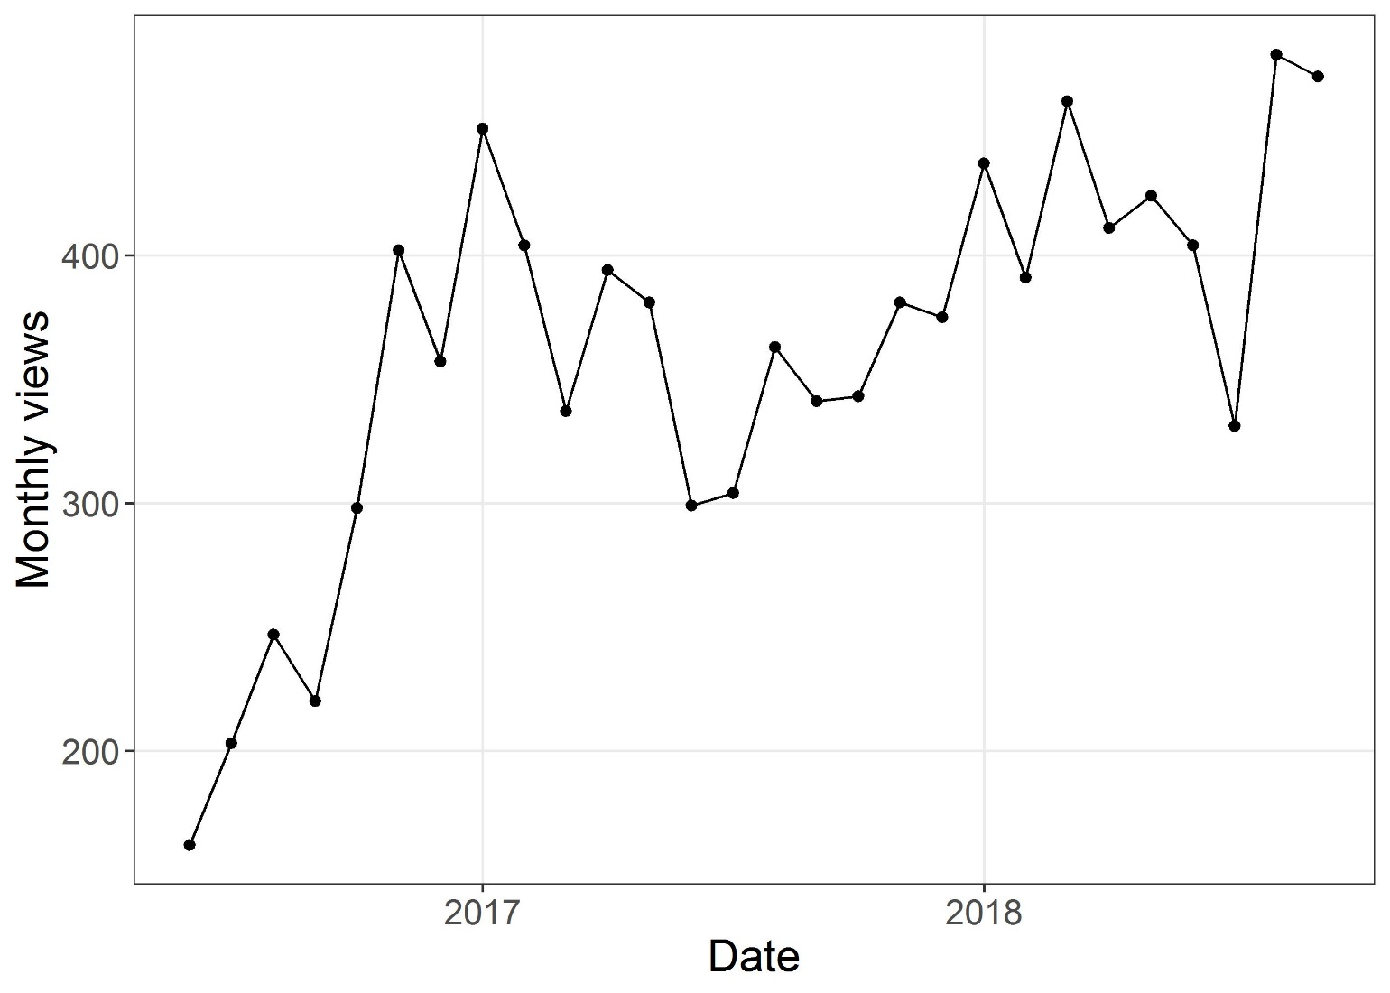
Wikipedia “meta-research” page, 10,000+ page views

Slide 16
Some ways of increasing your impact

Slide 17
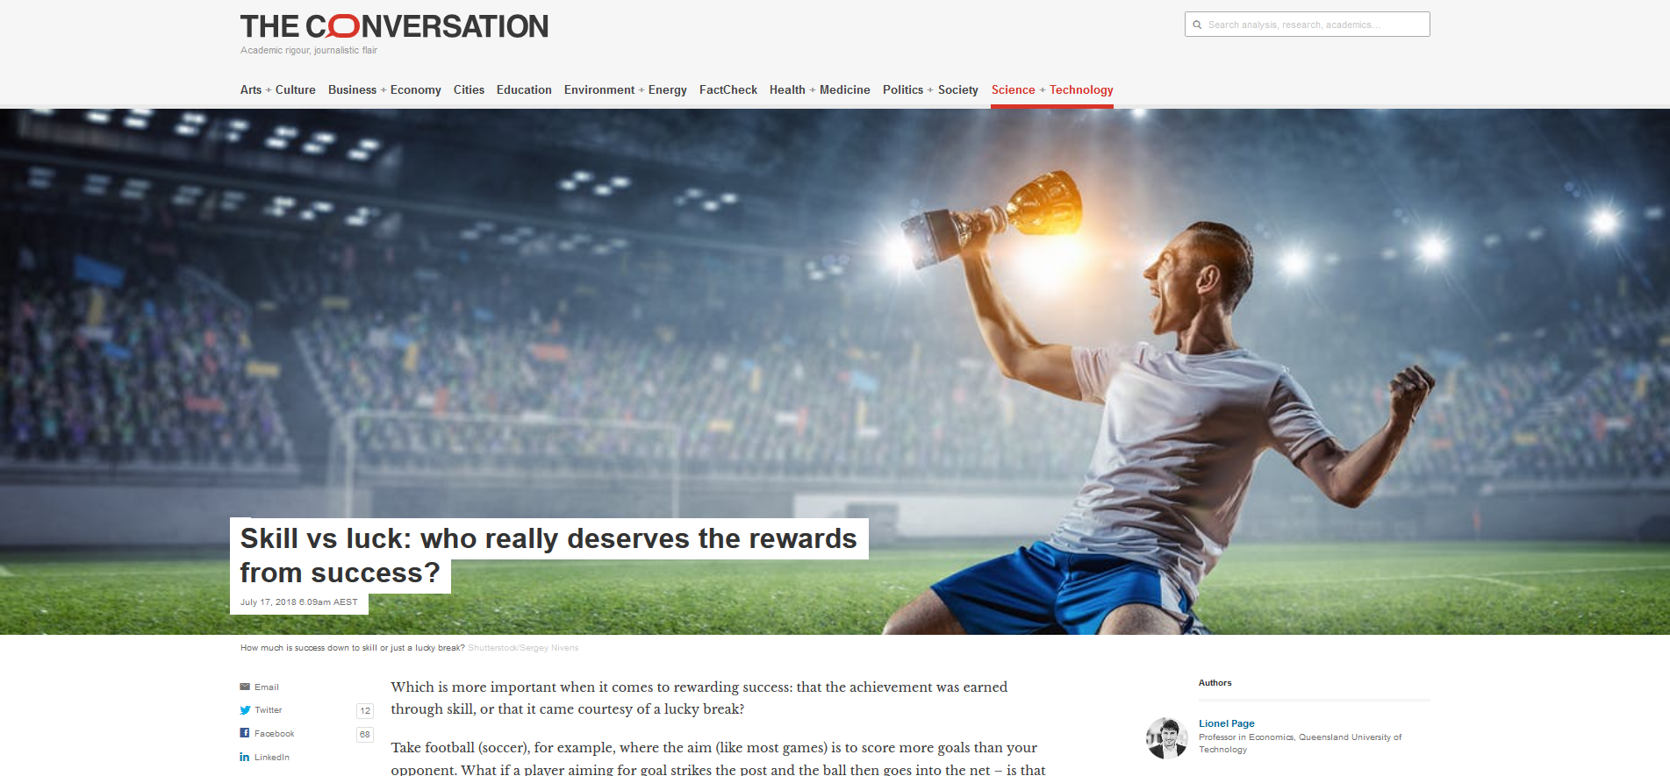

Slide 18

Be innovative

Slide 19
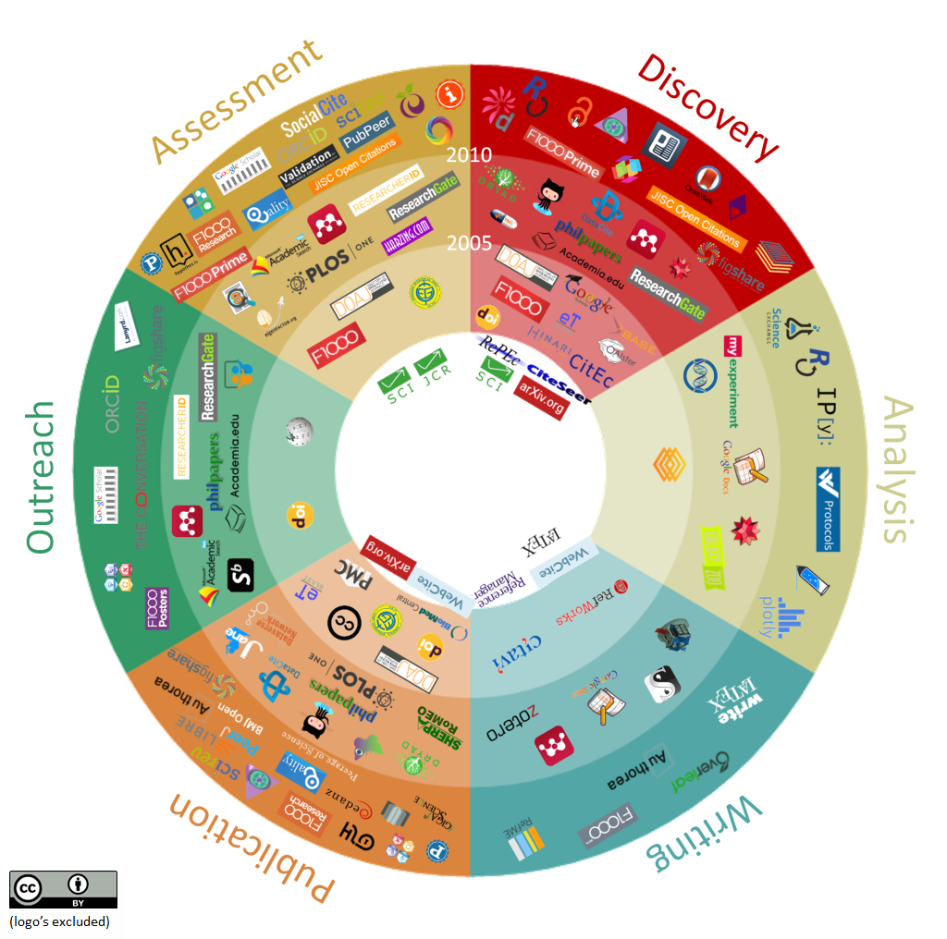
Innovations in scholarly communication https://101innovations.wordpress.com/

Slide 20
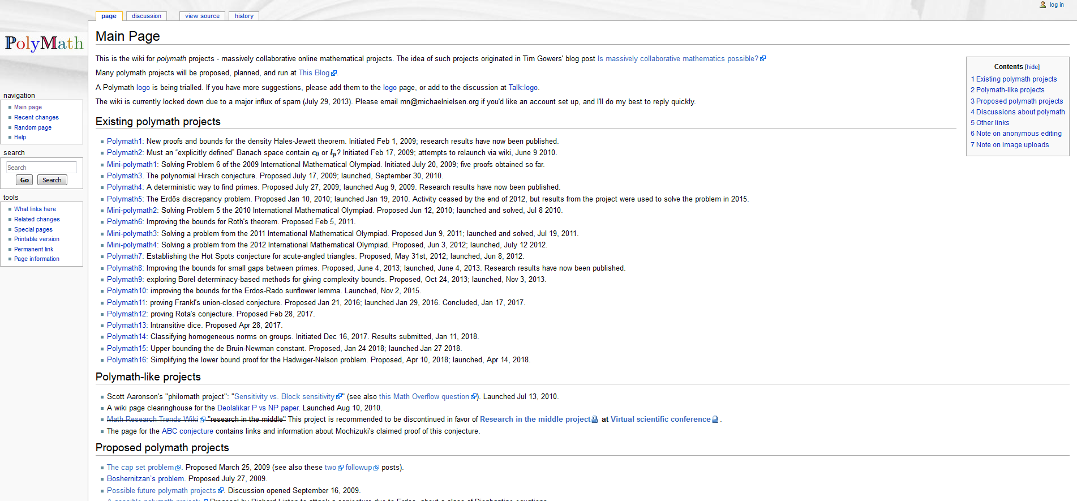
Polymath projects

Slide 21
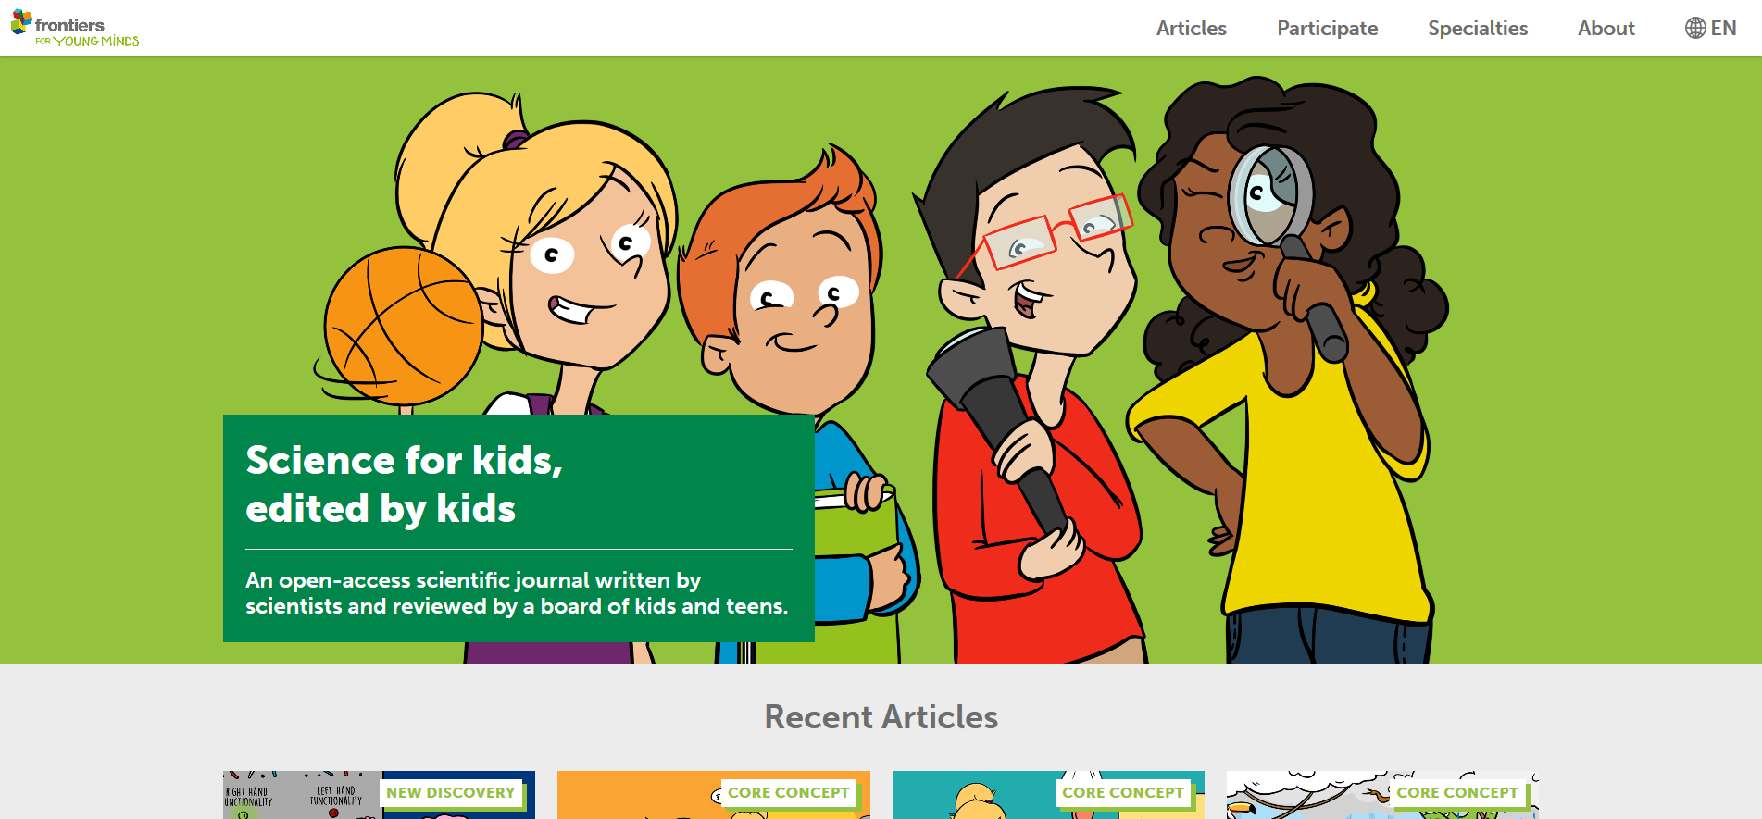

Slide 22
